Slide 1
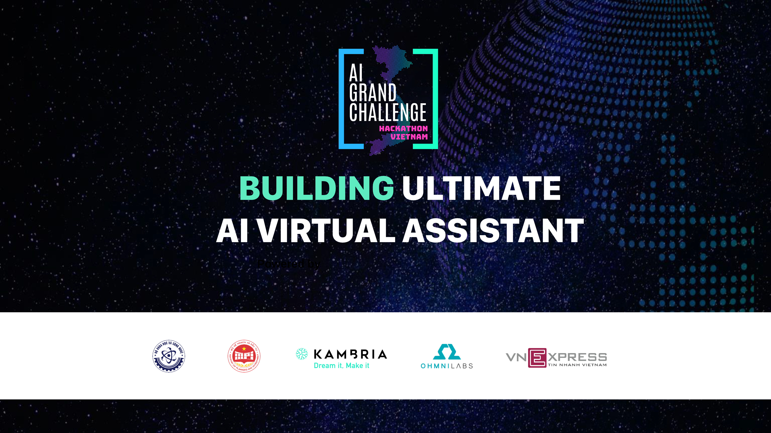

Slide 2
WhiteBunny
SMTHV

Slide 3
Who are we?
Lưu Trường Sinh -> dev
Nguyễn Quang Minh -> dev
Nguyễn Ngọc Trung -> dev

Slide 4
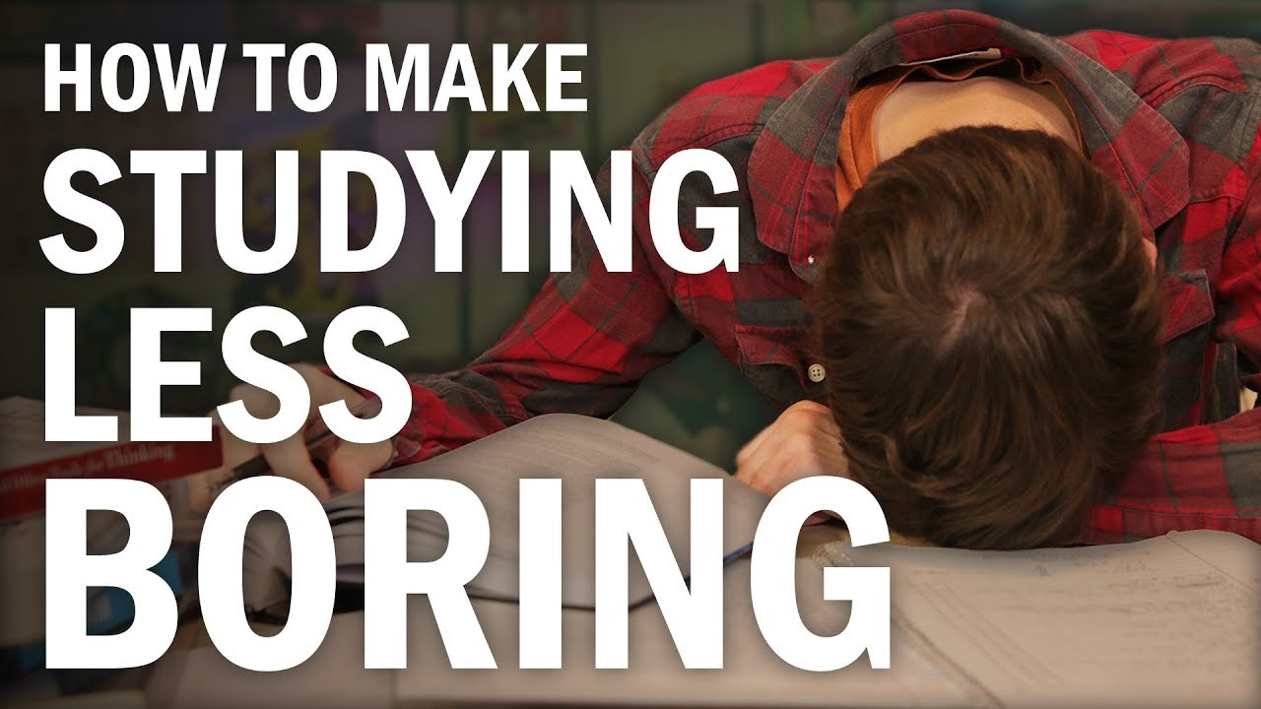
Problem Statement
Feeling bored when studying alone -> less effective

Slide 5
Solution
A chatbot that helps students to learn more effective and engaging

Slide 6
Three features
Insert 3 images here

Slide 7


Business Model
Sell chatbot service for educational organizations
Our team
create
serve
pay
Educational organizations
provide data

Slide 8
Execution Plan
Marketing strategy: create free chatbots for users to use

Slide 9
Thank you!

Slide 10
Participants
Sinh luu
sinhlt58@gmail.com
Trung nguyen
ngoctrunght19@gmail.com
Minh nguyen
nqminh164@gmail.com

Slide 11
Resource Slides

